Slide 1


3D Image Reconstruction using Open3D and Realsense Camera
By: Kommareddy Diana Mary
Under: Dr. Amit Shukla
Cair@IIT Mandi

Slide 2
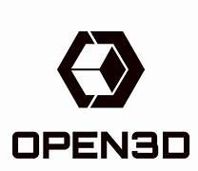
Open 3D
Open3D is an open-source library designed for 3D data processing, offering tools for working with point clouds, meshes, RGB-D images, and more. It is widely used in computer vision, robotics, and 3D reconstruction due to its ease of use and extensive functionality. The library supports rapid development of software dealing with 3D data, providing a robust set of data structures and algorithms in both C++ and Python through its well-designed frontend.
Supported operating systems:
Ubuntu 18.04+
macOS 10.15+
Windows 10+ (64-bit)
Open 3D has clear document explaining features, how to use, with basic code for beginners. Open 3D also provides datasets for practice.
Documentation: Introduction - Open3D 0.18.0 documentation

Slide 3
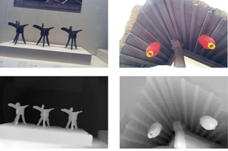
RGB-D Images
An RGB-D image combines an RGB image with its corresponding depth map. The RGB image uses the primary colors red, green, and blue to create a wide spectrum of colors. The depth map is a 2D grayscale image where each pixel's intensity indicates the distance to the camera. In the depth map, darker pixels represent farther points (value 0), and lighter pixels represent nearer points (value 255). Depth colormaps enhance depth interpretation by mapping depth values to a range of colors, highlighting different distances and structures in the image.
USES:
1. 3D Reconstruction: Creating 3D models of environments or objects.
2. Object Recognition: Enhancing object detection and classification by using depth information to distinguish between objects and backgrounds.
3. Robotics: Enabling robots to navigate and interact with their environment by providing detailed spatial information.

Slide 4
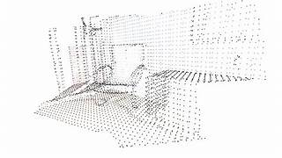
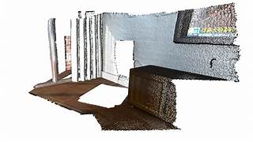
PointCloud
A point cloud is a collection of individual data points in a three-dimensional plane with each point having a set coordinate on the X, Y, and Z axis. When each point is placed together, it creates a three dimensional map or model. Depending on the data gathered and how dense the point cloud is, the more details and specific types of terrain and structures you’ll see.

Slide 5
Uses of Point Clouds of Depth images in Robotics
1. 3D Mapping : Creating detailed 3D maps of environments for navigation.
2. Object Detection and Recognition: Enhancing the accuracy of identifying and locating objects by providing spatial information.
3. Obstacle Avoidance: Enabling robots to detect and avoid obstacles by understanding their size, shape, and position in three dimensions.
4. Path Planning: Assisting in planning efficient and safe paths through complex environments by analyzing the 3D structure of the surroundings.
5. Manipulation and Grasping: Improving robotic arms' ability to accurately grasp and manipulate objects by understanding their 3D shape and orientation.
6. Environmental Interaction: Allowing robots to interact more effectively with their environment by providing a detailed 3D understanding of it.

Slide 6
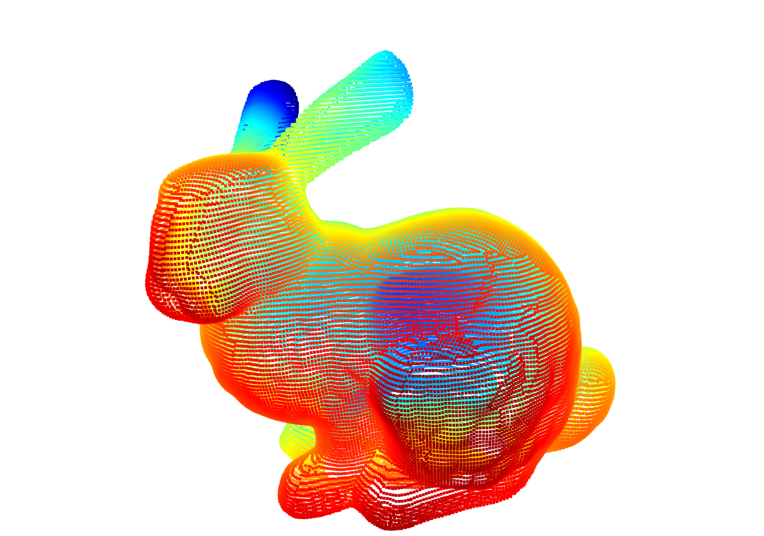
The basic Code and Output
CODE:
import open3d as o3d
pcd = o3d.io.read_point_cloud("C:\\Users\\Diana mary\\Downloads\\BunnyMesh.ply")
print(pcd)
o3d.visualization.draw_geometries([pcd])
OUTPUT:
Point Cloud with 35947 points.
Note: The input file is in .ply format to store 3D models as a collection of vertices, faces, and other elements. It can represent both geometry and color information.

Slide 7
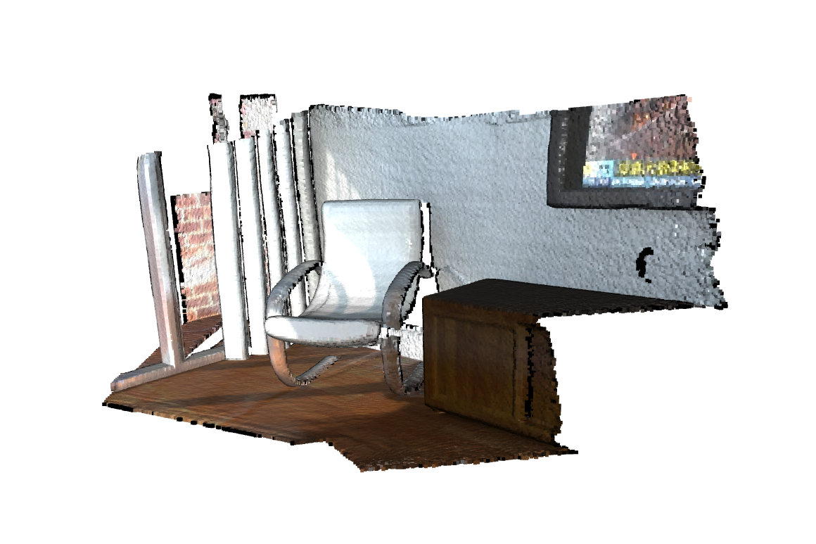
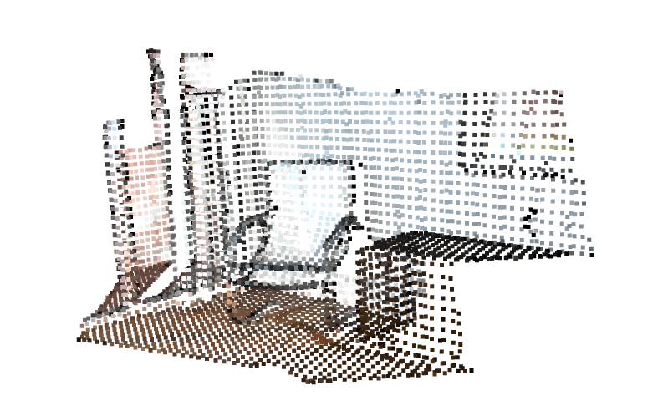
Downsampled Point Cloud
A downsampled point cloud is a version of the original point cloud that has been reduced in density. Downsampled point clouds are often used to reduce computational complexity and memory requirements in applications where high point cloud resolution is not necessary.
A voxel grid can be used to downsample a point cloud by replacing all points within each voxel with a single representative point. The pointcloud is downsampled to voxel value of 0.05.

Slide 8
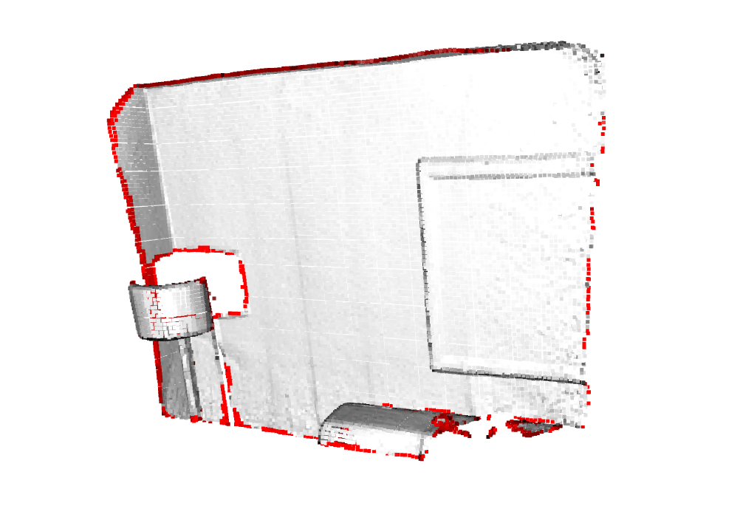
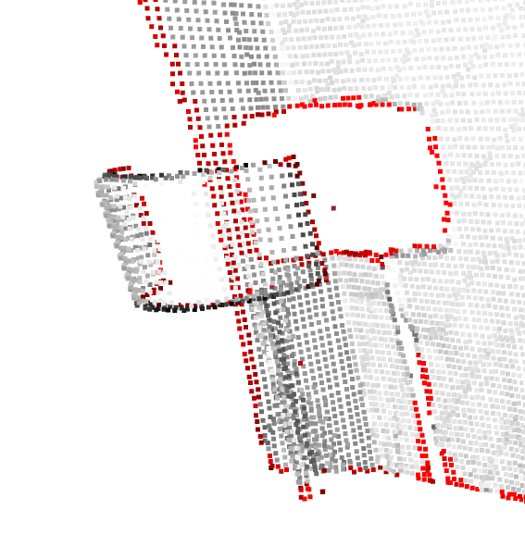
The Outliers and Inliers
Outliers: Outliers in a point cloud are points that significantly deviate from the overall pattern or distribution of points. These points may be the result of measurement errors, noise, or objects that do not belong to the main structure of interest. Outliers can negatively impact the accuracy of algorithms that rely on the point cloud data, such as registration or segmentation algorithms.
Inliers: Inliers are points in a point cloud that are considered to be part of the main structure or pattern of interest. They represent the majority of points in the point cloud that conform to the expected distribution or shape. Inliers are used to analyze and model the main features of the point cloud, excluding outliers.
Showing outliers (red) and inliers (gray):

Slide 9
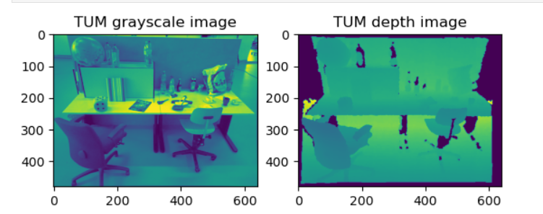
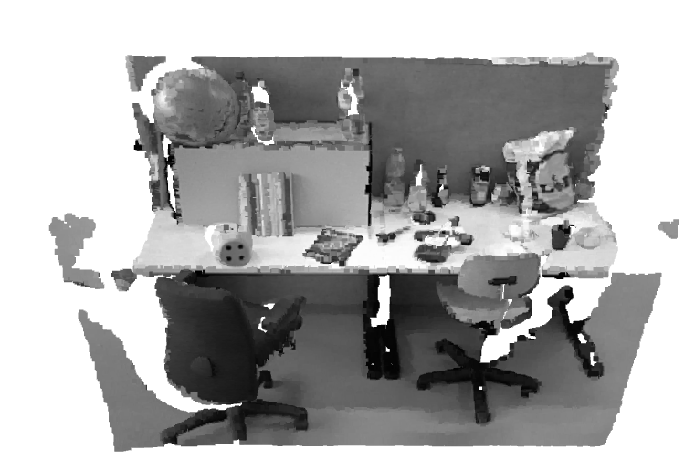
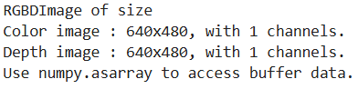
Point Cloud from RGB and Depth images
The point clouds can be formed from RGB image in form of .jpg and depth image in form of .png with same size.
Code:
color_raw = o3d.io.read_image("C:\\Users\\Diana mary\\Downloads\\SampleRGBDImageSUN\\SUN_color.jpg")
depth_raw = o3d.io.read_image("C:\\Users\\Diana mary\\Downloads\\SampleRGBDImageSUN\\SUN_depth.png")
rgbd_image = o3d.geometry.RGBDImage.create_from_sun_format(
color_raw,depth_raw)
print(rgbd_image)

Slide 10
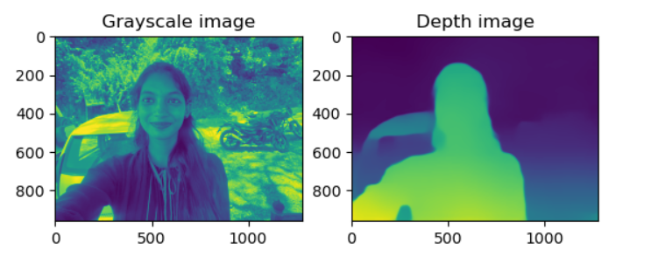
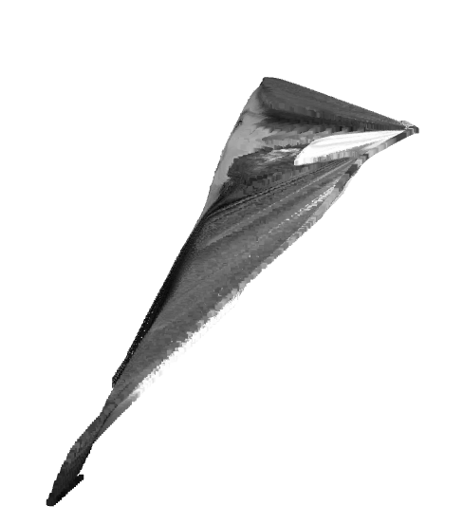
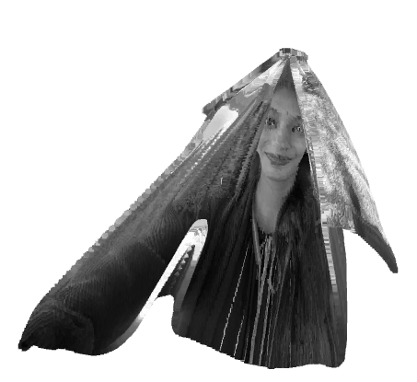
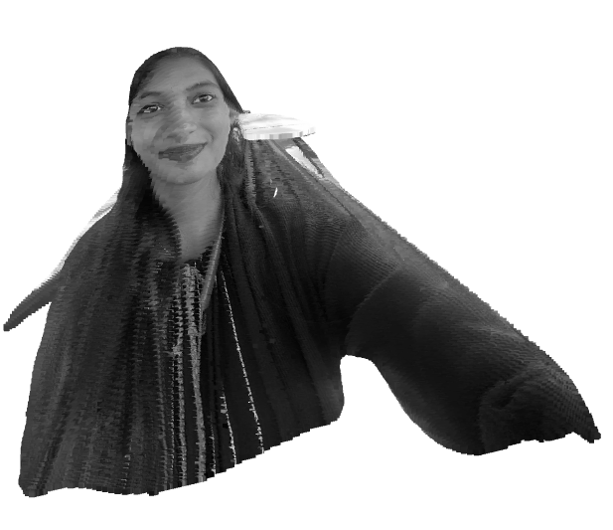
Customized input
The point cloud can be formed of a person by providing the rgb and depth images of same size.

Slide 11
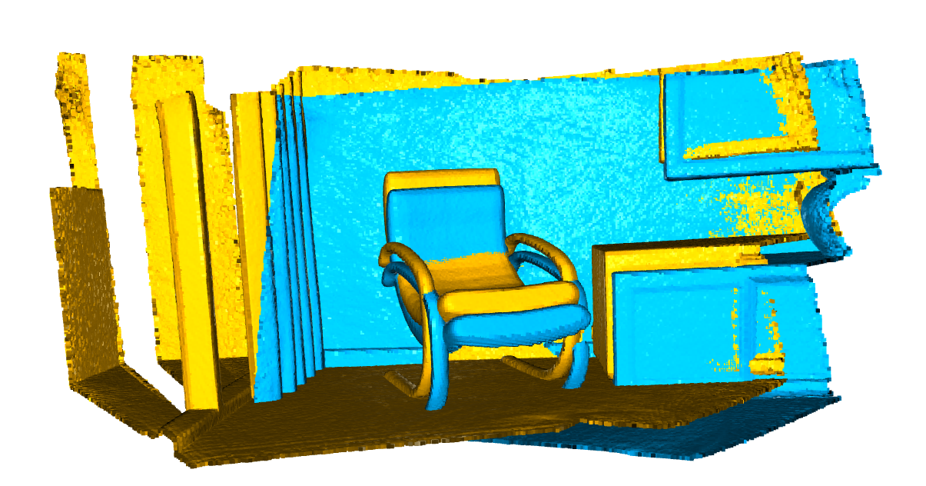
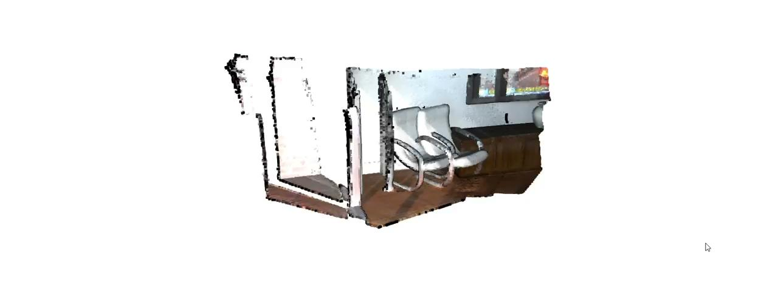
Alignment
Aligning two point clouds of different colors involves finding a transformation that minimizes the distance between corresponding points. Two common methods for this
1. point-to-point alignment
2. point-to-plane alignment.

Slide 12
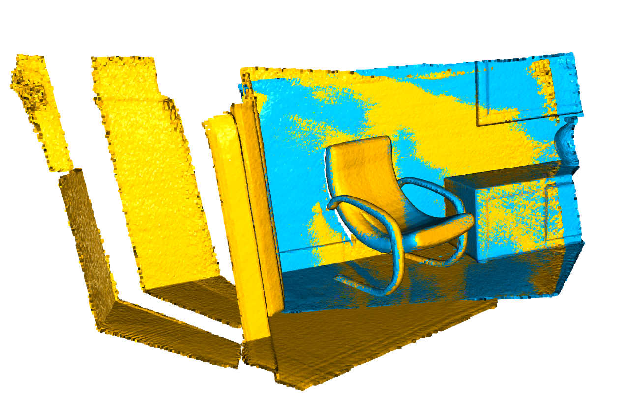
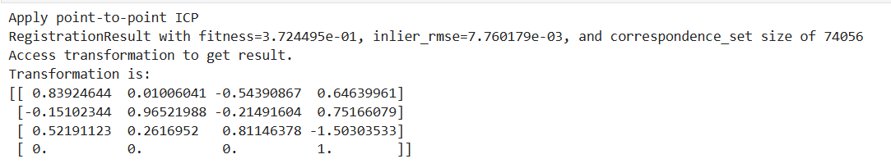
Point-To-Point
This method directly minimizes the Euclidean distance between corresponding points in the source and target point clouds. It iteratively refines the transformation by matching each point in the source point cloud to the nearest point in the target point cloud. The Iterative Closest Point (ICP) algorithm is a typical example of this method. It's simple and effective for cases where the point clouds are already roughly aligned, but it can be sensitive to noise and outliers.

Slide 13
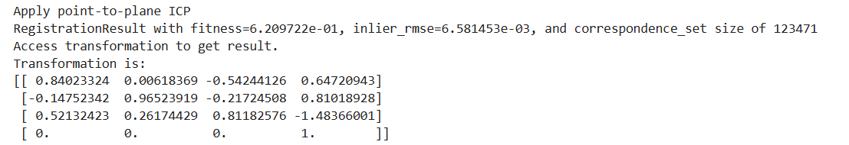
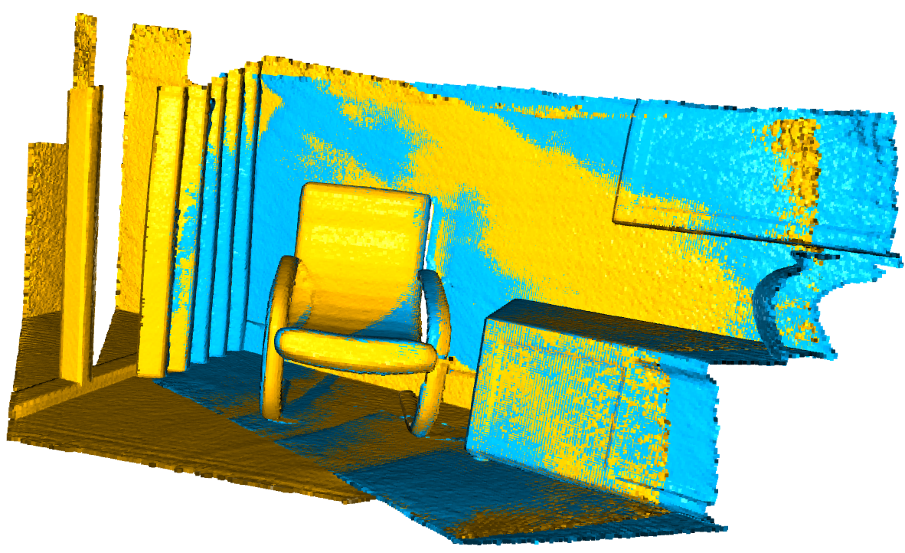
Point-To-Plane
This method minimizes the distance between a point in the source point cloud and the plane defined by the nearest point and its normal in the target point cloud. It tends to converge faster and more accurately, especially when dealing with surfaces because it takes the local geometry into account. The point-to-plane ICP algorithm extends the basic ICP by incorporating surface normals to improve alignment accuracy. This method is particularly effective when the point clouds have a smooth surface and when dealing with partial overlaps.

Slide 14
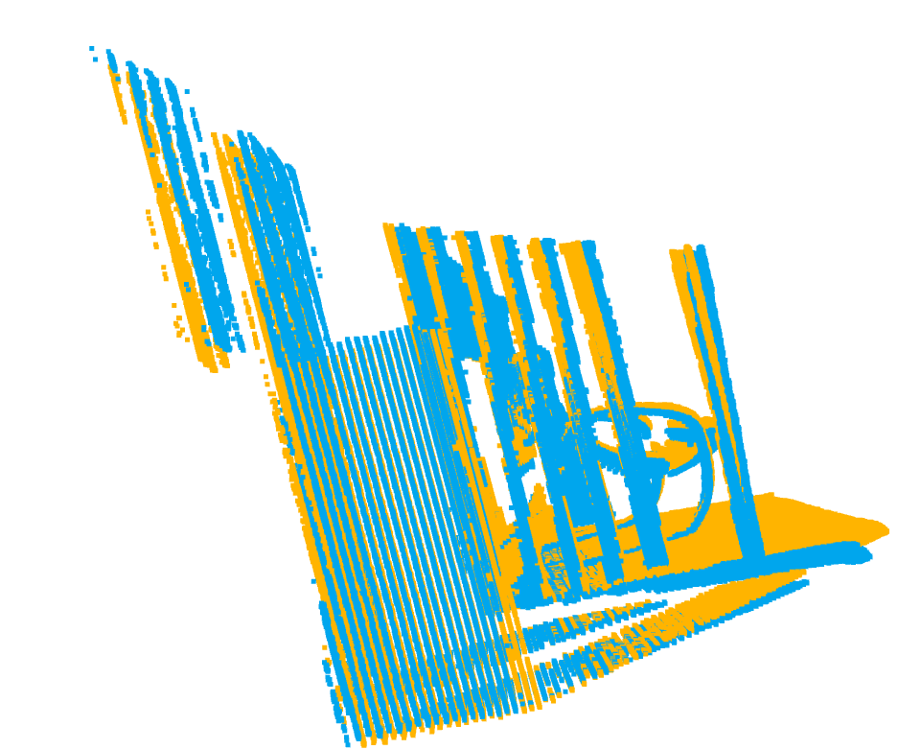
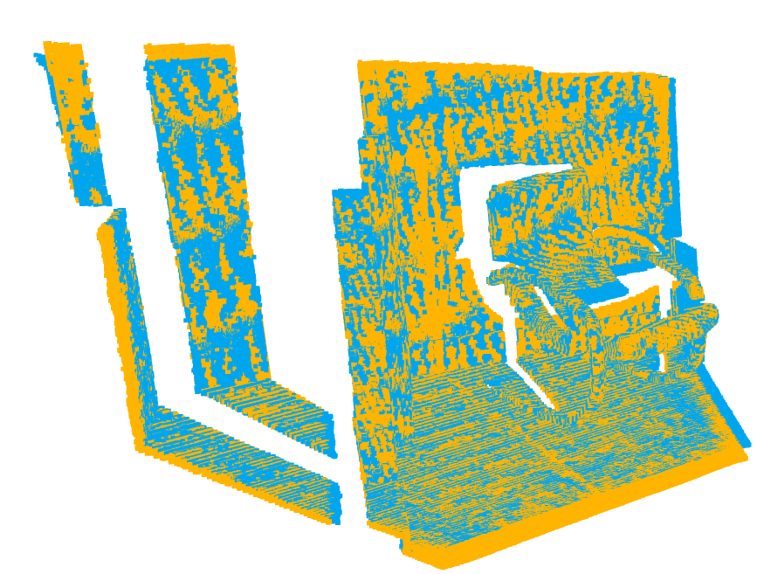
RGB-D Odometry
RGB-D Odometry is a technique used to estimate the motion of a camera by analyzing consecutive RGB-D frames (color images with corresponding depth information). Open3D provides functionalities to perform RGB-D Odometry, which can be useful in applications like visual SLAM, robotics, and AR/VR.

Slide 15
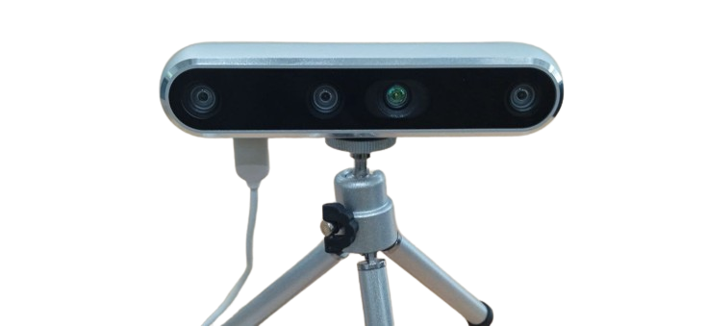
Depth Camera
The Intel RealSense Depth Camera D455 is a stereo-based depth camera designed for applications requiring precise depth sensing and 3D imaging.
Key features:
Stereo Depth Technology, Longer Range, Wide Field of View, High Accuracy, RGB Camera, Synchronization, IMU (Inertial Measurement Unit), USB Interface, SDK Support, Depth Technology: Active IR Stereo.
Specifications:
Depth Resolution: Up to 1280 x 720 at 30 fps.
RGB Resolution: Up to 1920 x 1080 at 30 fps.
Depth Accuracy: Within 2% at a range of 4 meters.
Minimum Depth Distance: 0.4 meters.
Maximum Range: Up to 10 meters with reduced accuracy.

Slide 16
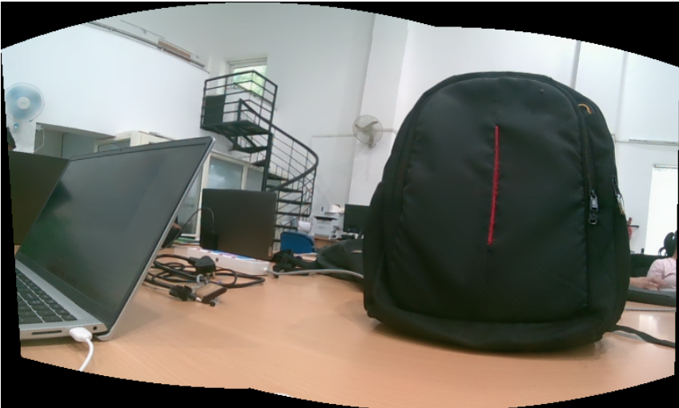
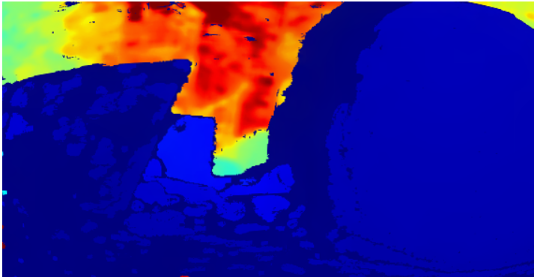
Image Stitching
Image stitching for RGB images and depth images involves combining multiple overlapping images to create a single seamless panoramic image or 3D model. This process typically involves feature detection, matching, transformation estimation, and blending for RGB images, and similar techniques adapted for depth images.

Slide 17
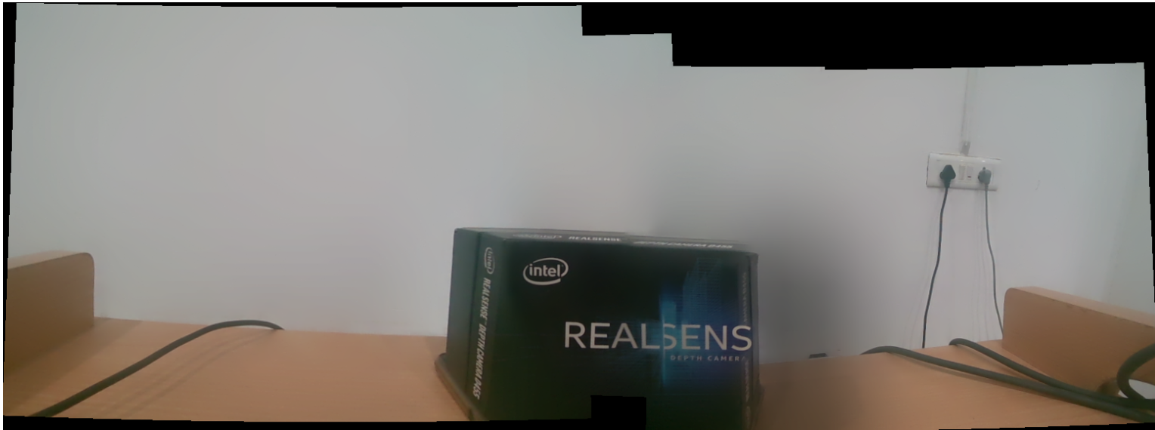
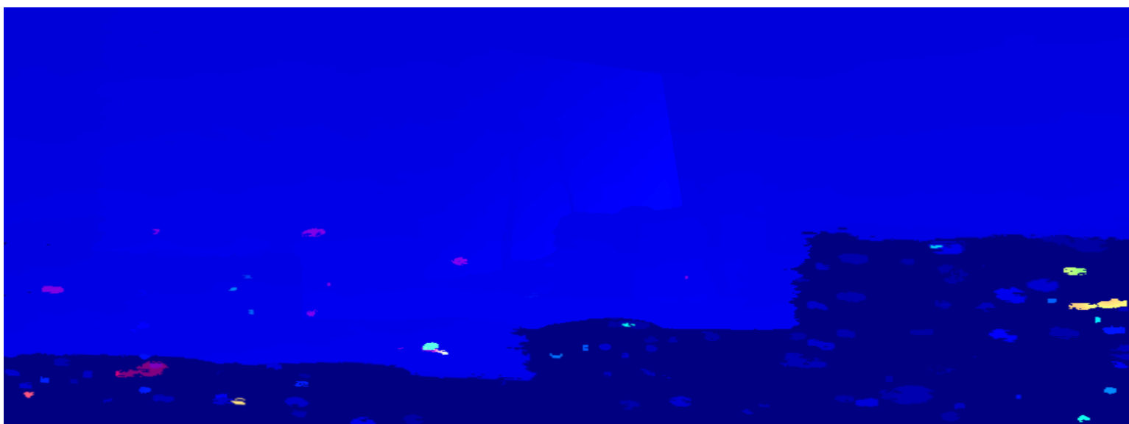
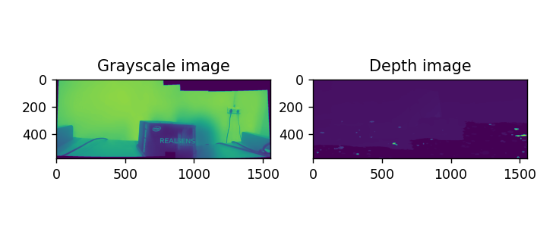
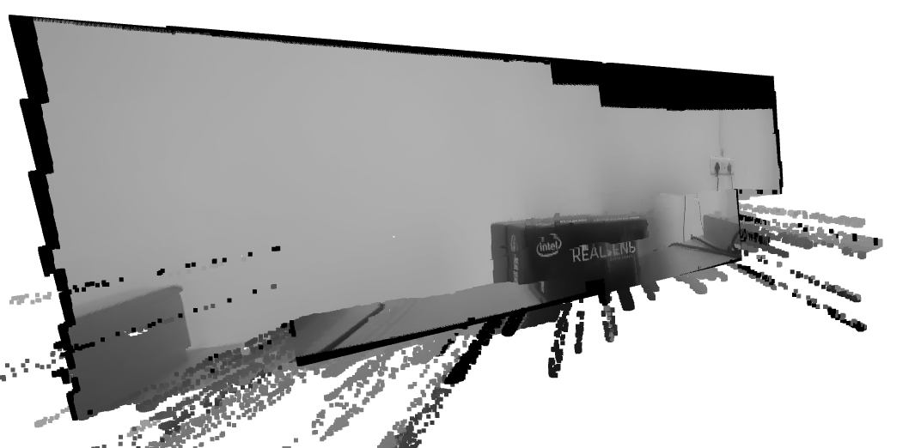
Point Cloud of The Stitched RGB-D images
Image stitching of RGB and depth images involves aligning and combining multiple pairs of RGB and depth images to create a comprehensive view of a scene. This process typically involves the following steps:
Capture RGB and Depth Images: Capture RGB and corresponding depth images using a depth camera like the Intel RealSense D455.
Align Depth to Color: Align depth images to the color images to ensure that the depth information corresponds to the correct pixels in the color images.
Stitch Images: Combine the aligned RGB-D pairs into a single, large image. This can be done using feature matching and homography.
Convert to Point Cloud: Convert the stitched RGB-D images into a point cloud.

Slide 18
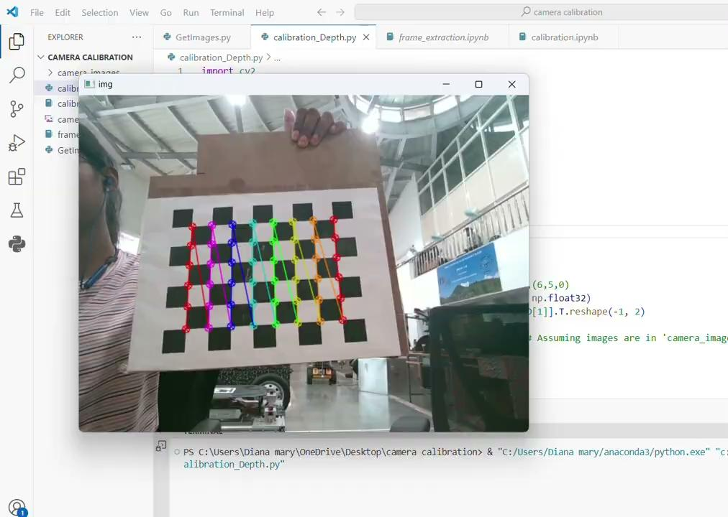
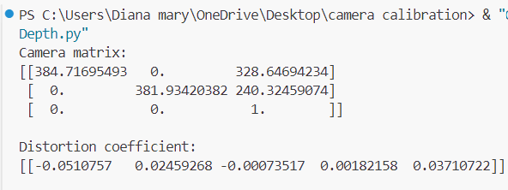
Camera Calibration
Camera calibration is a critical step in ensuring accurate depth measurements and alignment between the depth and RGB images. This process involves determining the intrinsic and extrinsic parameters of the camera.
Key Concepts
Intrinsic Parameters: These parameters define the internal characteristics of the camera, such as the focal length and optical center.
Extrinsic Parameters: These parameters define the position and orientation of the camera in the world coordinate system.
Depth-to-Color Alignment: This process ensures that the depth information corresponds accurately to the RGB image.

Slide 19
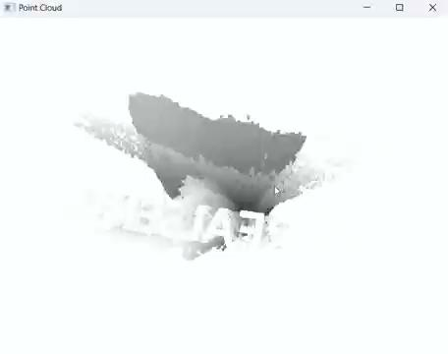
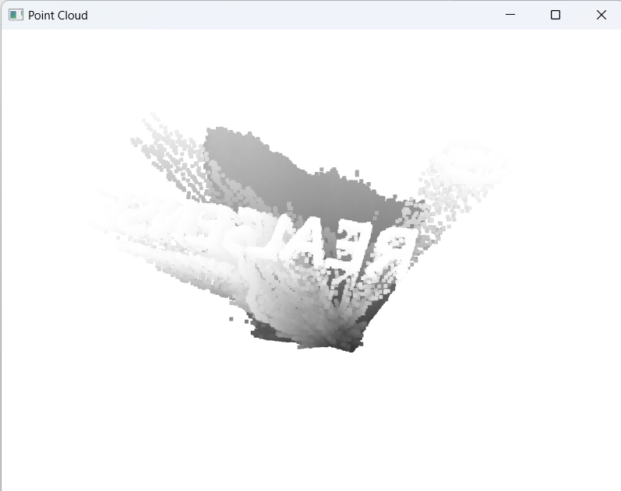
Highlighting Specific Features in Point Clouds
This is the point cloud of a box captured by the depth camera, displayed against a black background. The box features a name, which is white in color and stands out prominently. This method of point cloud visualization can be used to highlight specific information or features, making them more noticeable.

Slide 20
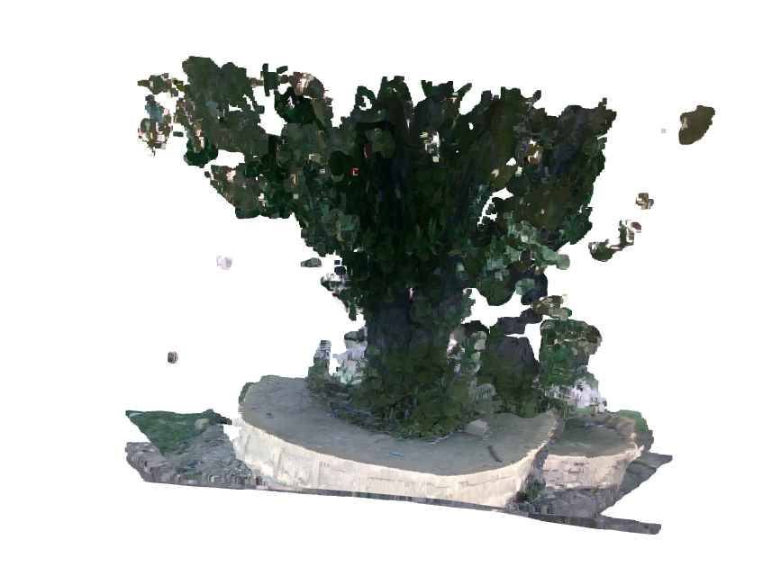
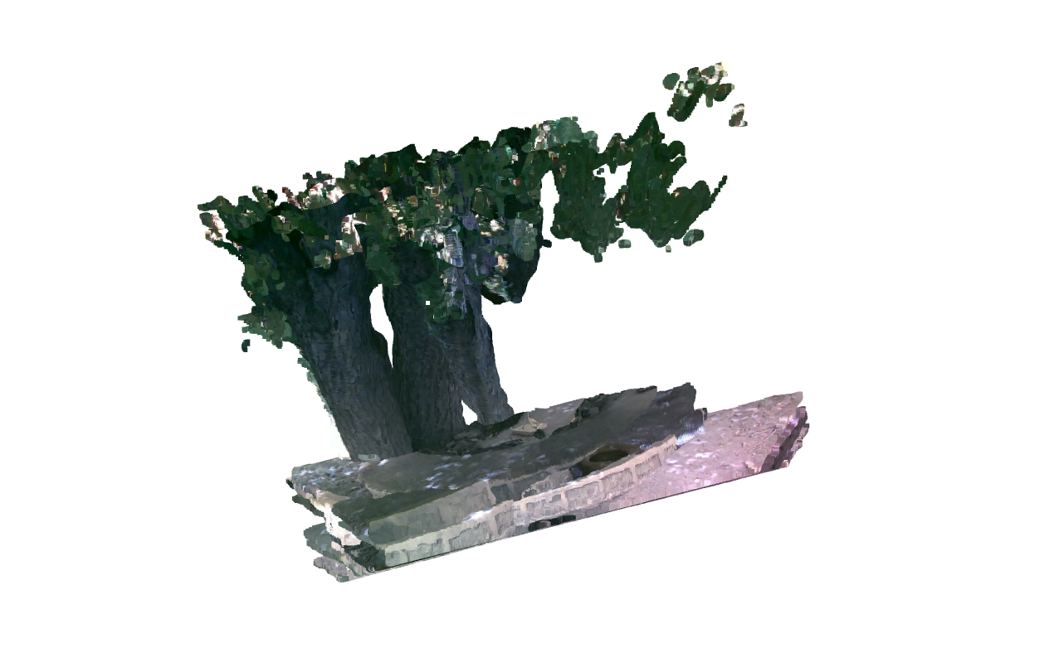
3D Point Cloud
A 3D point cloud is often created by combining multiple point clouds captured from different angles to form a single, comprehensive point cloud. This process involves aligning and merging the individual point clouds to accurately represent the complete surface geometry of an object or scene.

Slide 21
Thank You

